Slide 1
EIT Food FINANCIAL SUSTAINABILITY & Commercialization Strategy
From key exploitable results to Financial return for eit-food
Notes:
This webinar is about the EIT Food Financial Sustainability Mechanisms. We will provide you with an insight in the background and the important aspects of developing Financial Sustainability mechansism – such as revenue sharing – in the context of EIT Food funded KAVA projects. My name is Ron Weerdmeester European Innovation Manager for PNO Group and my name is Marco Karremans, Managing Director of PNO Corporate Finance. PNO is a European leader in Innovation and Funding, and supports the EIT Food and its partners and KAVA consortia to design suitable Financial Sustainability Mechanisms.

Slide 2


SPECIFIC EXPERTISE COLLABORATION WITH EIT FOOD
EU funding and innovation consultants
track record supporting exploitation and business planning, in a.o. agro-food, bio-economy and process industry
hands-on collaborations with ≥ 400 EU consortia every year; large industries, startups, SMEs, research organisations & Universities.
PNO has supported EITs: Climate KIC, EIT Health, EIT Raw Materials
Support EIT Food in the domain of financial sustainability strategies and ROI mechanism :
Assessment of the project’s risk profile, proposed ROI-mechanism, business case, the project’s risk profile and define possible points of attention to tackle in reaching final agreements end 2020 - 2021
Collection follow-up data and in-depth assessment on business case and ROI mechanism, e.g. key exploitable results (KERs), revenue model analysis, realistic quantification of Serviceable Obtainable Market (SOM) and go-to-market strategies.
Advise both EIT Food and project consortia in preparing risk-adjusted and fair agreements on ROI mechanism per project.
Strategic support on longer term sustainability strategies for EIT Food
Ron Weerdmeester
Manager PNO Group Innovation Team
Expertise: EU RD&I projects, PPPs management and strategy
Marco Karremans
Manager Corporate Finance Team
Expertise: Investor readiness, investor match, business case and Finance arrangements

Slide 3

Agenda
Objective: understanding what is expected from a good Financial Return mechanism (FRM) and commercialisation strategy for EIT food funded projects:
BACKGROUND OF fRm
FRM’s in the context of kava proposals and projects
Frm IN THE EVALUATION PROCESS
WHAT DOCUMENTS AND DATA TO PROVIDE
FRM SCOPE AND AGREEMENT
Conditions for a sound self-developed fRm
      Clear KERs
      Who owns and has exploitation rights (IPR)
      Business Model related to the KERs
      Business Case(s) for exploiting partner(s)
      Clear FRM related to credible market introduction perspective
COMMERCIALISATION AND FRM TEMPLATE
RECAP - SOME KEY RULES FOR DESIGNING YOUR FRM
Q&A
Notes:
So, the objective of this webinar is to support you in understanding what are sound Financial Sustainability Mechanisms – or FSM in short, and what is expected from KAVA consortia when they prepare their proposals, to increase the chances for a good evaluation of your FSM as part of your exploitation proposal. Our agenda looks as follows: 1) First we will give you some background on the FSM’s; where does it come from and what is its purpose. 2) Then we’ll zoom into the types of FSMs in EIT Food, 3) how their development is embedded in the KAVA proposals and project implementation process, and 4) what are the elements for developing sound FSM’s. In this webinar we will provide some further in-depth information on what is meant by Key Exploitatable Results, IPR, how you may use the business model canvas, important elements of business cases, and last but not least; 5) What information and data you could provide to increase the chance for a positive evaluation of your proposed FSM.
Ok, so let’s start!

Slide 4
BACKGROUND OF FRM
Financial sustainability for eiT-food

Slide 5
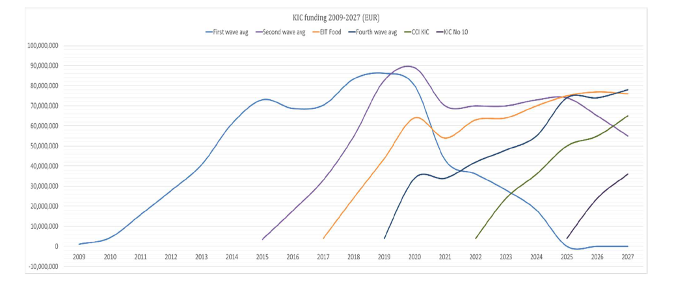
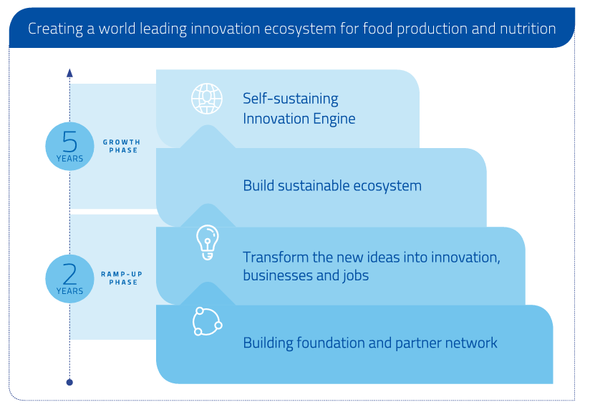
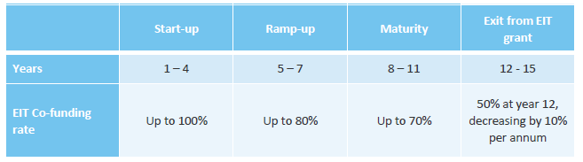
EIT FOOD SUSTAINABILITY STRATEGY

Slide 6
Background OF financial sustainability in eit
The EIT regulation state that “mechanisms must be introduced and should generate returns that should be reinvested into the KIC to leverage other funds” and ensure Financial Sustainability.
In line with the EIT Food Financial Sustainability Strategy and EIT requirements, all Innovation Activities are required to give a financial return to EIT Food to support the long-term financial sustainability plan (e.g. from NGOs, services sales, investment in start-ups, etc.). FRM’s were introduced in Call for Proposals Guidelines since 2019*
The FRMA details the mechanism designed to contribute to the financial sustainability of EIT Food based on the Activity´s successful commercialization. In other words, it is a “success fee” related to the exploitation of the Activity´s Key Exploitable Results supported by EIT.
* See also art. 9.A Additional agreements for sustainability purposes of the EIT Food Grant Agreement
Notes:
As you may be preparing or evaluating a proposal for the EIT-FOOD KAVA funding, you may already know that since 2019, the requirement to propose a Financial Sustainability Mechanism has been integrated in KAVA calls. This is based on the EIT Regulation and the HORIZON programmes that are funding the EIT. Their regulations state that the EIT’s should introduce «mechanisms that … should generate returns to be reinvested into the KIC to leverage other funds” EIT-Food is building the foundations for such sustainability through both short term and long term results, fostering income streams aimed at reaching a self-financing level of at least 40% within 7 years. Pay-back mechanisms for EIT funded KAVA projects are leveraging on successful KAVA’s that manage to exploit their funded results. As such KAVAs contribute to leverage efforts by EIT Food to develop further alternative income streams which are part of the long-term sustainability plan, such as contributions from NGO’s, service sales, investment in start-ups such as Rising Food stars etc. All to contribute to “making the food system more sustainable, healthy and trusted”

Slide 7
BACKGROUND OF FRM
FRM in the context of kava projects

Slide 8


FRm in the context of kava PROJECTS
KERs, exploitation plan and FRM in your proposal
Further elaborate exploitation ideas
Collect the input from partners and desk studies
Finalise your Exploitation and business Plan
Exploitation decision by the exploiting partner/
exploitation of results
FRM agreement (FRMA) with EIT Food
Proposal
Evaluation
KAVA project
Market
Business Case + FR mechanism
Specific FSM Agreement
IP and business models
Further market analysis
Detailed business Plan
Implement
ROI/FR mechanism
KER’s -> IP ->Business Modelling -> Market analysis -> Business Plan-> go to market
Notes:
As already indicated, the preferred FRM already needs to be indicated in your KAVA proposal. In all cases, your proposal, being an Innovation Action will target early market introduction of your project results, often indicated as “Key Exploitable Results”. It is hence important to indicate which are those KERs and how they will be exploited, what the market looks like and what revenues are expected to be generated. A well elaborated exploitation plan, already in the proposal phase, will contribute significantly to a positive evaluation of your proposal. During the project implementation, you would typically go through a number of steps to finetune agreements with your KAVA consortium partners, to define even better your KERs, agree on IPR, carry out further market analysis and develop detailed exploitation and business plans, to foster market introduction. A Specific FRM Agreement will need to be signed with EIT Food before the project starts. At the end of the project, the project results will, or will not be commercialised, and depending on your FRM, in the years following your funded project will lead to FR contribution to EIT Food.

Slide 9

FRM in EVALUATION PROCESS
Financial return mechanisms is explicit part of the evaluation
PART A
External Experts will evaluate Part A of all applications which pass eligibility and include the
Excellence Impact : 40 %
Impact Pathways: 30%
Quality and Efficiency KPIs : 30 %
PART B
Proposals that will proceed to PART B of the evaluation process, will be evaluated more in depth by Experts on the same criteria

Slide 10
FRM in EVALUATION PROCESS
Financial return mechanisms is explicit part of the evaluation: PART A
Excellence 40% |  | Impact pathways and KPIs 30% |  | Quality and efficiency of implementation 30%
25% | *Clearly demonstrated market and societal need/demand for the proposed innovation | 40% | Proposal significantly contributes towards EIT Food’s Societal, Environmental, Economic impact. There is a clear link between the project’s KPIs and Impact Indicators. | 40% | Value for Money of the proposed activity. Extent of proposal’s co-funding rate will be reflected in the evaluation score.
25% | Innovativeness of the proposed solution, advancing state of the art in the field. | 40% | Proposal’s intended impact is significant, as measured by the # of EIT Core KPIs and additional KIC-specific KPIs for Innovation, in particular: • Marketed Innovations • Designed and Tested Innovations • Start-ups created • Innovation testbeds established Extent of proposal’s intended impact will be reflected in the evaluation score. | 40% | Competences, operational capability, and complementarity of the consortium to achieve project objectives
25% | *Soundness/credibility of the business concept and robust commercialisation strategy | 20% | Clearly demonstrated collaborative strength and synergies of consortium to contribute to the EIT Food Focus Area Challenges with the innovation(s) being developed. | 20% | Adequate resources (human and financial) to achieve project objectives
25% | Stage of development of the innovation and its critical/non-critical technologies is clearly demonstrated
1st level of evaluation of your FRM

Slide 11
FRM in EVALUATION PROCESS
Financial return mechanisms is explicit part of the evaluation: PART B
Excellence 40% |  | Impact pathways and KPIs 30% |  | Quality and efficiency of implementation 30%
25% | Consortium’s research and analysis of market need is clearly demonstrated. Value proposition for consumers is clearly demonstrated | 30% | Effectiveness and feasibility of the workplan are clear and convincing to achieve project objectives. Thorough and comprehensive risk register and corresponding mitigation plan. | 40% | **Ambitious commercialisation strategy and COMPETITIVE Financial Return Mechanism contribution to KIC's Financial Sustainability
25% | Business plan is well researched and convincing. Uniqueness of the innovation is clearly demonstrated. | 40% | **Extent, relevance, and timeliness of contribution from project-level KPIs and Impact Indicators towards overall KIC KPI targets and Societal Impact Indicator targets. | 40% | Revenues expected from the Key Exploitable Results (KER) are realistic. The market assumptions of said revenues are thoroughly explained. A robust IP management plan is in place.
25% | **Convincing Proof of TRL stage of at least 7 at the time of proposal submission, in the form of prototypes, data, feedback from tests/ trials, consumers' assessment, that show evidence of completion/achievement of TRL 6. | 15% | Strength of Economic Impact, via forecasted income and through wider economic, societal, health or environmental gains which can be attributed to the activity. | 20% | The ramp up in expected annual revenues is realistic and substantiated by project milestones for market introduction and commercial scale-up.
25% | Feasibility to increase the TRL level of the innovation within the timeframe of the proposed activity is realistic and clearly explained. | 15% | Demonstration of Knowledge Triangle Integration, through contribution of EIT Food support/ programmes/ network/ capability & resources to the development, deployment and scaling up of solutions and Impact Goals.
In-depth evaluation of your FRM

Slide 12
Clear Financial return mechanism
WHAT DOCUMENTS AND DATA TO PROVIDE?

Slide 13
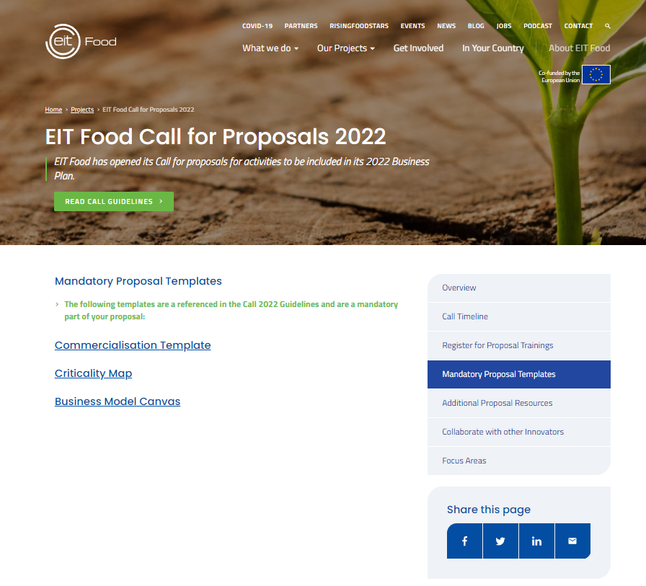
Mandatory documents TO BE PROVIDED
https://www.eitfood.eu/projects/eit-food-call-for-proposals-2022#tab3
  Business Model Canvas
  Commercialisation and Financial Return Mechanism Plan (Template)
    Supporting Documentation explaining expected Serviceable & Obtainable Market (SOM) and market share
    Supporting Documentation describing sales/distribution channels for the SOM
    Supporting Documentation of Product Readiness Level
Notes:
Supporting Documentation explaining expected SOM and market share, e.g. draft /expected offtake agreements, letters of intent customers, market research reports, competitor analysis).
Supporting Documentation describing sales/distribution channels for the SOM (Business Plan).
Supporting Documentation of Product Readiness Level: evidence documenting the status of the activities required to launch the innovation in the market.

Slide 14
Clear Financial return mechanism
FRM SCOPE AND AGREEMENT

Slide 15

Scope Financial Return Mechanism and MINIMUM ROI
  Revenue sharing: sharing % of revenues generated by exploited KER(s) during agreed time period
  Credible Business Case; projected revenues based on market, team, milestones GtM / scale up
  Return on Investment (ROI) of EIT’s funding to a KAVA: sum of revenues shared annually
  Minimum required ROI: 50% of EIT grant budgeted for KAVA, incl. budget amendment
  Proposals with ROI > 50% considered more ambitious; a higher score in criterion ‘ambition and competitiveness of mechanism’ in Part B evaluation;
  For a multi-annual KAVA: minimum ROI 50% of total EIT funding (sum of annual grants provided)
  Example minimum expected return:
      if the total proposed budget is 1 M EUR, of which 60% funded by EIT Food, or 600 K EUR
      then propose a mechanism that provides return ≥ 300 K EUR within acceptable timeframe
      Consider a higher return if your project has a higher risk factor
Notes:
A suitable Financial Return Mechanism may be based on revenue sharing, i.e. sharing a percentage of revenues generated by the Key Exploitable Result(s) (KERs) during an agreed time period within the agreed exploitation period, or on another mechanism proposed by the exploiting party/ parties.
Sum of revenues shared annually for an agreed period of time is the Return on Investment (ROI) of EIT’s funding to a KAVA
As a minimum threshold, the minimum required financial return shall be 50% of the EIT grant budgeted for the lifetime of the Activity. Any subsequent budget amendment resulting from the monitoring process and approved through the Business Plan amendment process will be taken into consideration, should the budgeted EIT grant change over time.
Activities selected for funding under the Regional Innovation Scheme have preferential financing conditions, and the expected financial return shall be 35% of the EIT grant budgeted for the lifetime of the Activity, with any lower proposed financial return being taken into consideration during the evaluation process.
Cap amount
For multi-annual KAVA: ROI is on total EIT funding (sum of annual grants provided)
For example, if the total proposed Activity budget is 1 M EUR, of which 60% is reimbursed by EIT Food, or 600 K EUR, then the exploiting party or parties must propose a mechanism which provides a return of at least 300 K EUR upon commercialisation, within an acceptable timeframe. The example above illustrates the minimum expected return; proposals with a greater financial return would be considered more ambitious and achieve a higher score in subcriterion (1) above

Slide 16

Key Considerations in proposing financial Return mechanism
  Start year and end year of revenue sharing:
    Exploitation KERs to start 2 years at latest after KAVA ends and revenue sharing cannot exceed 6 years.
    If targeted ROI is not reached within projected period: continuation of revenue sharing until the ‘cap amount’ is achieved, up to 6 years after start exploitation.
    Exploitation is monitored; in case no revenues generated, EIT Food may request Access rights KER(s).
Your proposal
X% of revenues for Y yrs up to Z% of the EIT funding (ROI)
KERs
1 - 2 years
Max 2 years
Max 6 years
Start KAVA
End KAVA
Start Exploitation
Your proposed end FR
Maximum FR period
  Example ‘risk adjusted’ return
  Exploitation after 2 years KAVA end-date; extra 2% may be foreseen; ROI 52% of EIT funding
  If in addition, revenue sharing in 4 years; extra 2% return per year (in total ROI 60% of EIT funding).
Notes:
It is up to the exploiting party/parties to propose a reasonable “risk adjusted” financial return, which may require an additional percentage of return above the minimum required amount. The proposed risk-adjusted success fee should consider the specific risk profile of the market for Key Exploitable Results. In particular, Consortia should consider the following:
o The proposed and agreed time phasing of the return shall be the start year and end year of the revenue sharing (exploitation period). Please note that nearby market introduction of the KERs after the Activity is assumed. Therefore, the start of the exploitation period must take place at the latest two years after the Activity ends. Also note that the total allowed exploitation period linked to the revenue sharing cannot exceed six years. If the proposed percentage for the financial return mechanism is not reached by the end of the agreed period, then the financial return mechanism shall continue until said percentage is achieved, with the limit of six years after the start year.
o During the exploitation period (two years after the Activity ends and a maximum of six years), the progress of the Financial Return Mechanism shall be evaluated by EIT Food and in case that no revenues have been generated during said period, EIT Food reserves the right to request the grant of the Access rights of the Key Exploitable Results from the Consortia.
o The credibility of the Business Case for Key Exploitable Result(s) of your Activity, concerning the underlying parameters of the projected revenues: market, team, product (key exploitable results) and milestones for go-to-market and scale up.
As an example,
the if the Financial Return Mechanism is expected to start after 2 years from the KAVA end-date, an additional 2% reimbursement could be foreseen (total proposed mechanism should be 52% of total EIT food funding). If additionally, the reimbursement is foreseen in a time period of 4 years, an additional 2% financial return per each year could be proposed (in total 60% of EIT funding).
Special considerations
EIT Food acknowledges that the instance may arise where a proposed Activity exceeds expectations in terms of Impact, but the consortium may have difficulty in providing the expected financial return. Therefore, proposals which consistently score an average of 5 across the 3 sub-criteria for “Impact Pathways and KPIs” during the Part A evaluation will exceptionally be allowed to reduce the minimum required financial return to 35% based on risk criteria, once the evaluation processes for Part A & Part B have been completed.
However, all such proposals must still comply with the minimum required return of 50% of budgeted grant at proposal submission. → TRL min. 7 (completed level 6 must be completed and demonstratable).
Please note that all Education programmes embedded in proposals must use the suite of EIT Food Education services and infrastructure to ensure alignment and inclusion in the course catalogue. For proposals including an “Education” component, the Financial Return should include a 50% revenue share of course fees.

Slide 17


SPECIAL cases of frm
KAVAs under RIS: expected financial return 35% of EIT grant budgeted:
EU Member States: Bulgaria, Croatia, Cyprus, Czech Republic, Estonia, Greece, Hungary, Italy, Latvia, Lithuania, Malta, Poland, Portugal, Romania, Slovakia, Slovenia, Spain.
Horizon Europe Associated Countries*: Montenegro, Republic of North Macedonia, Serbia, Turkey, Ukraine.
Outermost Regions: Guadeloupe, French Guiana, Réunion, Martinique, Mayotte and Saint-Martin (France), the Azores and Madeira (Portugal), and the Canary Islands (Spain).
* These third countries, which are all listed in the European Innovation Scoreboard, will be eligible for the EIT RIS, following the successful conclusion of individual Horizon Europe Association Agreements
  Education programmes embedded to use EIT Food Education services and infrastructure; “Education” component to include 50% revenue share of course fees.
Notes:
Special considerations
EIT Food acknowledges that the instance may arise where a proposed Activity exceeds expectations in terms of Impact, but the consortium may have difficulty in providing the expected financial return. Therefore, proposals which consistently score an average of 5 across the 3 sub-criteria for “Impact Pathways and KPIs” during the Part A evaluation will exceptionally be allowed to reduce the minimum required financial return to 35% based on risk criteria, once the evaluation processes for Part A & Part B have been completed.
However, all such proposals must still comply with the minimum required return of 50% of budgeted grant at proposal submission. → TRL min. 7 (completed level 6 must be completed and demonstratable).
Please note that all Education programmes embedded in proposals must use the suite of EIT Food Education services and infrastructure to ensure alignment and inclusion in the course catalogue. For proposals including an “Education” component, the Financial Return should include a 50% revenue share of course fees.

Slide 18

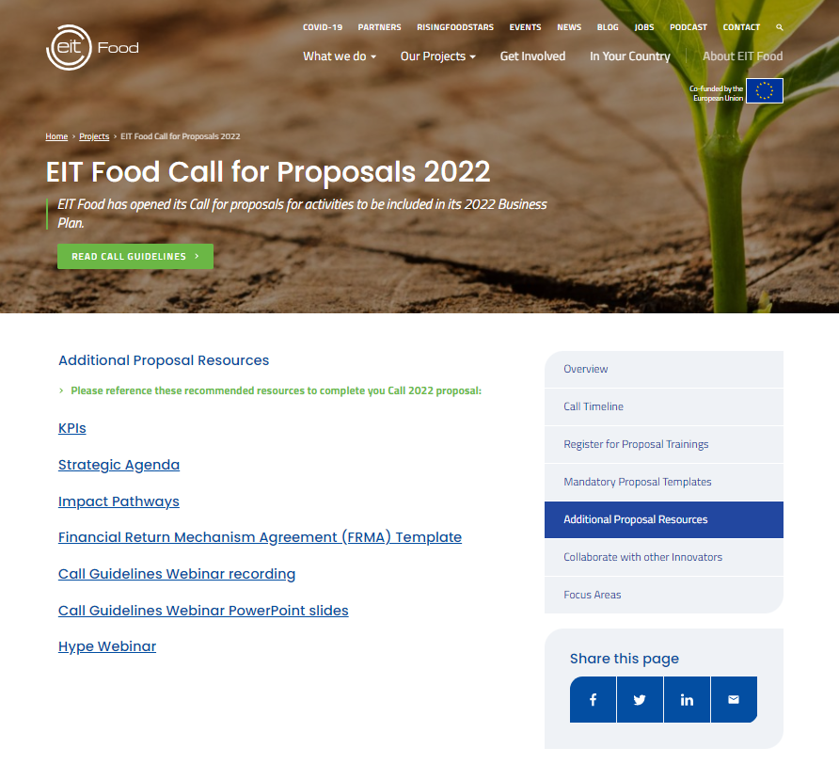
Agreement FOR Financial Return Mechanism
  Mechanism proposed by exploiting party/parties finalised with EIT Food after the proposal’s selection.
  Financial Return Mechanism Agreement (FRMA)
  Signed with the exploiting party/parties of the consortium, on behalf of Activity consortium.
  Signed as a mandatory condition for funding.
  Should be finalised before the activity commences.
  In case multiple KERs by multiple exploiting partners, each relevant exploiting partner must co-sign FRMA.
  Exploiting party or parties must be an already existing legally registered company at the time of application.
  The terms of the FRM:
  Will be documented in a Term Sheet as an attachment to the FRMA
  FRMA template is available, including framework of term sheet:
    https://www.eitfood.eu/projects/eit-food-call-for-proposals-2022#tab4
Notes:
Mechanism proposed by the exploiting party/parties will be finalised with EIT Food after the proposal’s selection.
A Financial Return Mechanism Agreement (FRMA) must be signed with the exploiting party/parties of the consortium, on behalf of all e members of the Activity consortium.
The Agreement will be finalised according to EIT Food FRMA terms and conditions.
The FRMA must be finally agreed and signed by the Exploiting Party(ies) and EIT Food as a mandatory condition for funding.
A Financial Return Mechanism Agreement (FRMA) will be signed between EIT Food and the exploiting party (or parties) of each Activity.
The terms of the FRM will be documented in a Termsheet as an attachment to the Financial Return Mechanism Agreement. The FRMA should be finalised before the activity commences.
The FRMA template, including the framework of the term sheet as annex to the FRMA structure, is provided on the website: https://www.eitfood.eu/projects/eit-food-call-for-proposals-2022#tab4 (the term sheet template provided may be subject to further modifications or adaptations to adapt to the corresponding Activity).
In case multiple KERs are to be exploited by multiple exploiting partners, each relevant exploiting partner must co-sign the FRMA to commit to the agreed financial return generated by its KER(s).
The exploiting party or parties must be an already existing legally registered company at the time of application.

Slide 19
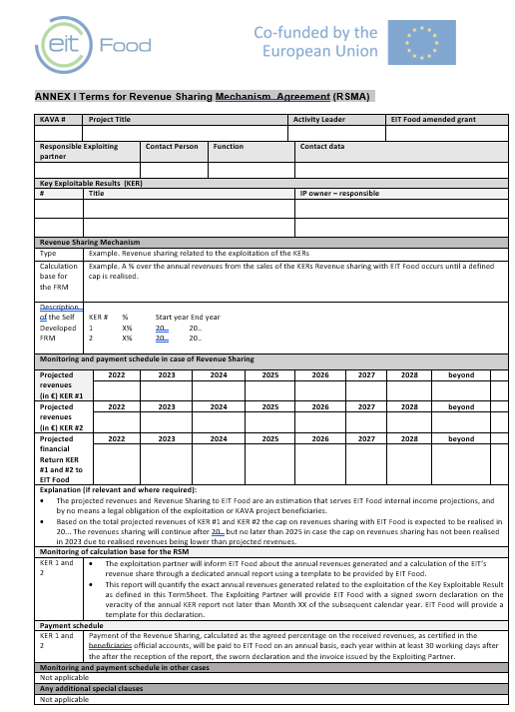
Agreement FOR Financial Return Mechanism
Terms sheet – attach to the frma
Definition of ker’s
Ownership – ip
CalCulation base of the frm
Estimated payment schedule for rs
Monitoring rules
Notes:
Mechanism proposed by the exploiting party/parties will be finalised with EIT Food after the proposal’s selection.
A Financial Return Mechanism Agreement (FRMA) must be signed with the exploiting party/parties of the consortium, on behalf of all e members of the Activity consortium.
The Agreement will be finalised according to EIT Food FRMA terms and conditions.
The FRMA must be finally agreed and signed by the Exploiting Party(ies) and EIT Food as a mandatory condition for funding.
A Financial Return Mechanism Agreement (FRMA) will be signed between EIT Food and the exploiting party (or parties) of each Activity.
The terms of the FRM will be documented in a Termsheet as an attachment to the Financial Return Mechanism Agreement. The FRMA should be finalised before the activity commences.
The FRMA template, including the framework of the term sheet as annex to the FRMA structure, is provided on the website: https://www.eitfood.eu/projects/eit-food-call-for-proposals-2022#tab4 (the term sheet template provided may be subject to further modifications or adaptations to adapt to the corresponding Activity).
In case multiple KERs are to be exploited by multiple exploiting partners, each relevant exploiting partner must co-sign the FRMA to commit to the agreed financial return generated by its KER(s).
The exploiting party or parties must be an already existing legally registered company at the time of application.

Slide 20
ADDITIONAL ACCESS RIGHTS
  Art. 2.4. The EIT Food Partners acknowledges and agree that the Exploitation of the Results of the KAVA shall start at term agreed for the exploitation and detailed in the Term- Sheet
  Art.2.5. if at any moment during the Exploitation Period the exploitation Results are not expected to generate any revenues, the KIC LE reserves the right to claim additional Access Rights
  commitment letter with the confirmation of the cease of the exploitation
  Article 8: Additional Access Rights for KIC LE – Right to disseminate
  exclusive or non-exclusive, fully paid-up, irrevocable, world-wide Access Rights to use the Results of the KAVA for the enhancement of the KIC EIT Food and the EIT Food Partners, for example for use in scientific papers, benchmarking. Such access rights shall include the right to grant sublicenses.
  The EIT Food Partners will continue to own the Results of the KAVA they have generated. EIT Food does not request to transfer the ownership of the Results from the EIT Food Partners.
Art. 2.6. The KIC Partners shall be liable towards the KIC LE for the infringement of the commitment of cease of the exploitation and will indemnify KIC LE with an amount equal to the max the agreed ROI (agreed % of the EIT Funding)
Notes:
Mechanism proposed by the exploiting party/parties will be finalised with EIT Food after the proposal’s selection.
A Financial Return Mechanism Agreement (FRMA) must be signed with the exploiting party/parties of the consortium, on behalf of all e members of the Activity consortium.
The Agreement will be finalised according to EIT Food FRMA terms and conditions.
The FRMA must be finally agreed and signed by the Exploiting Party(ies) and EIT Food as a mandatory condition for funding.
A Financial Return Mechanism Agreement (FRMA) will be signed between EIT Food and the exploiting party (or parties) of each Activity.
The terms of the FRM will be documented in a Termsheet as an attachment to the Financial Return Mechanism Agreement. The FRMA should be finalised before the activity commences.
The FRMA template, including the framework of the term sheet as annex to the FRMA structure, is provided on the website: https://www.eitfood.eu/projects/eit-food-call-for-proposals-2022#tab4 (the term sheet template provided may be subject to further modifications or adaptations to adapt to the corresponding Activity).
In case multiple KERs are to be exploited by multiple exploiting partners, each relevant exploiting partner must co-sign the FRMA to commit to the agreed financial return generated by its KER(s).
The exploiting party or parties must be an already existing legally registered company at the time of application.

Slide 21
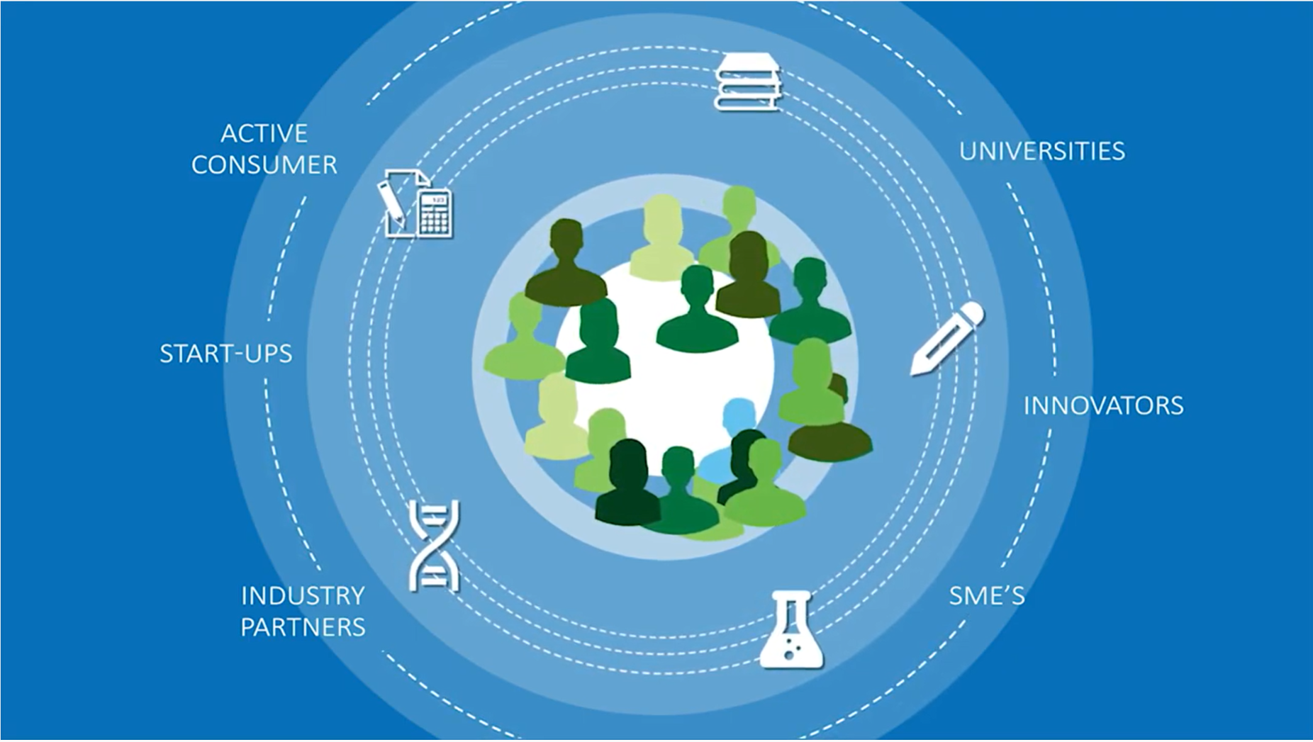
Conditions for a sound Financial Return mechanism
1. Clear KERs
2. Who owns and has exploitation rights (IPR)
3. Business Model related to the KERs
4. Business Case(s) for exploiting partner(s)
6. Clear agreements between partners about responsibilities for FRM (consortium agreement)
5. Sound and credible commercialization and go-to-market strategy
Notes:
So, as you saw, the key elements for a sound self/developed FSM are 1) Clear KERs, 2) a clear agreements on IPR and exploitation rights between the partners, 3) a valuable Business Model around the KERs, 4) quanitified and credible business cases for the exploiting partners, and 5) a Clear Agreement between the partners about the responsibilities to pay-the FS contribution to EIT. They need to be developed at a very early stage, for a large part already before the start of the project, and be clearly outlined in the proposal. In the following part of the webinar, we will go a bit deeper into each of these elements, to provide you with some theoretical background and context to be used when elaborating your proposal.

Slide 22
Key exploitable results
And how to develop an exploitation plan
Notes:
So let’s start with the KERs

Slide 23
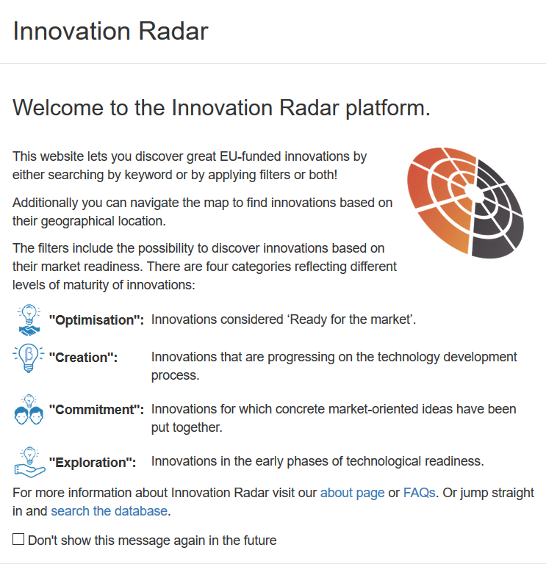

(Key) Exploitable results ((K)ER))
What is an exploitable result?
A product, new service, new standard, new training courses:
  will be further developed for market introduction after the project end
  responds to a specific need of a well-defined group of customers/users
How can an ER be exploited:
  Direct use: Manufacturing, Industrialization; Selling of technology/product; Research Consultancy for external clients; New research project; Training/ new university course
  Indirect use: Distribution and licensing agreements; Development of a new legislation standard; Joint ventures; Start-up/ Spin-off company
What are the differences among KER and ER:
  KER: Result selected for building a full business plan;
  ER: no full business plan. ER example: new university course, input for new project due to a spin off research from the project
Notes:
What are Key Exploitable Results? Each project generates Exploitable Results, such as a new scientific knowledge, a new material, a new ingredient, a new product, process, service, standard or even training courses. Many innovative results of EU Funded projects can be found in the well known EU’s Innovation Radar, which has the objective to foster their exploitation. These results often meet specific user needs, such as higher crop yields, healthier food, reduced water use, recycling of food waste and so on. Each KIC Partner has the obligation to take measures to ensure exploitation of its results, e.g. by using them for further research, exploiting a product, process or service or using them in standardisation or other activities within the knowledge triangle. The exploitable results often need to be further developed for market introduction and exploitation, so they can be manufactered, industrialised and sold to clients. This can be done directly by the KAVA partners, or by third parties through distribution or license agreements. Not all Exploitatable Results however are Key Exploitable Results, in the context of our FRM. A valuable Exploitable Result can be a new university course for instance on sustainable enzymatic production of food ingredients, or new scientific knowledge on nutritional values of crops. They may but doesn’t necessary have to be exploited commercially. For the purpose of our FSM, we define Key Exploitable Results (KERs) as those ER’s that will lead to a business plan for commercial exploitation. They often can be a combination of Exploitable Results. Let’s look at an example …

Slide 24

Smart farming - example
What are ker’s?
Who owns them?
Who exploits them?
What does the market look like?
What part of the market will you capture?
Who earns what?
Notes:
Smart farming offers huge opportunities for our society in terms of more sustainable food production, e.g. through better use of fertilizers, optimsing yield of crops, combatting water scarcity through precision irrigation. At the same time it offers huge business opportunities for farmers, their suppliers and service providers. A KAVA consortium could be focussing on developing next generation solutions for ‘smart farming’ based on satelite imaging, weather prediction, crop monitoring through drones and new sensors integrated in agricultural machines, as well as crop-growth forecasting integrating all these elements into a web-based application. Such a web-based application, is combining a number of Exploitable Results into Key Exploitable Results. New scientific knowledge on crop-growth based on nutritional values is an exploitable result. New Algorithms to predict crop-growth based on multiple monitored characteristics as well. However, they become a Key Exploitable Result, when they are combined into a sellable product or service, such as new sensors to be integrated into agricultural machines, or the Crop-monitoring webservice that can be sold to farmers or service providers that help farmers to optimise their agricultural strategies. To understand the commercial market potential of the KAVA results it is hence essential for each project to ask: ‘what are the Key Exploitable Results’ of my project, who owns them, and who exploits them. To which market? How large is that market, and what part of that market can you realistically capture. All elements we will further elaborate on later on in this webinar.

Slide 25
IPR – some basic principles
Notes:
let’s look at the question – ‘who owns them’, or who has the Intellectual Property Rights?

Slide 26
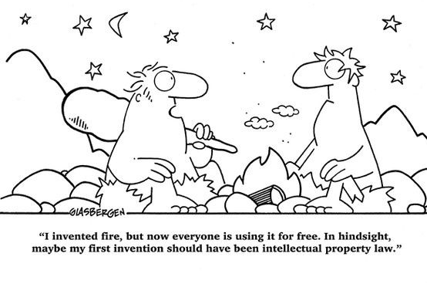
Managing ipr during implementation
Notes:
It is important to never forget to carry out a ‘Freedom to Operate’ analysis as part of your exploitation plan, and already indicate in your proposal that you are fully aware on your ‘rights to commercialise the KAVA results’.

Slide 27
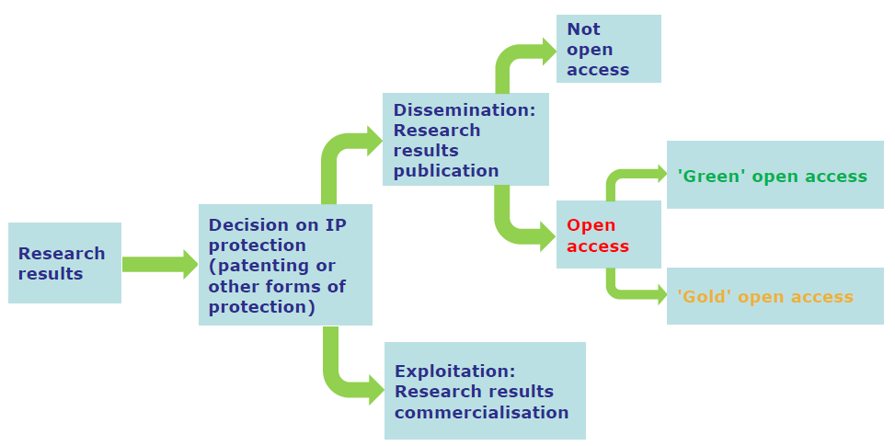
Managing ipr during implementation
Project results are owned by the partner(s) that developed (or acquired) them!
Don’t forget to carry out a ‘Freedom to Operate Analysis’!
14.9 Consortium agreement for the KAVA
EIT Food Partners (and as the case may be KIC LE) shall enter into a consortium agreement for the KAVA(s) they are involved in, in order to specify or supplement binding commitments among themselves in addition to the provisions of the FPA and the SGA, in particular with respect to ownership of Results and Access Rights.
EIT Revenue sharing mechanism
Notes:
Project Results are owned by the (KAVA) partners that developed (or acquired) them, previous to the project or during the project. Each KAVA project will have to develop an exploitation and dissemination strategy, consiliating the interest of IP owners that want to exploit and those that want to publish, or both. IP owner will need to decide their IP strategy, meaning if they need or want to protect them or not, how to deal with confidentiality, publication rights of academic partners, and the possible infringements on IP from third parties. Each KIC partner must examine the possibility of protecting its results and must adequately protect them if reasonable, possible and justified.

Slide 28
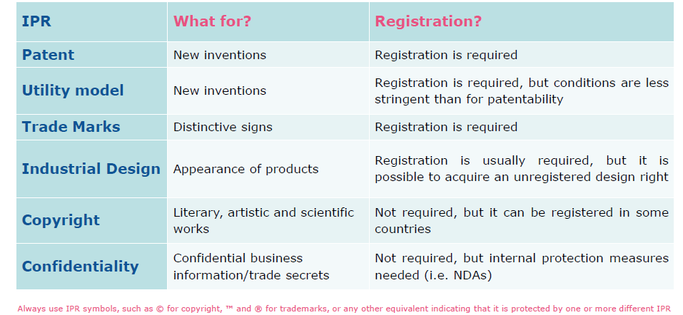
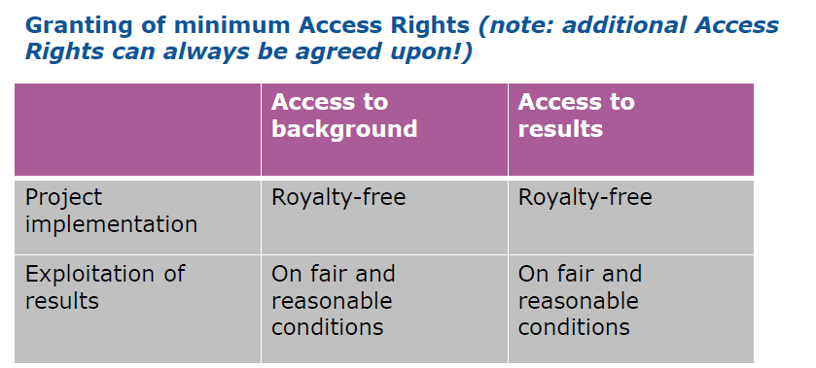
ipr – protection and access rights
*
IP protection and access rights are relevant to understand ROI mechanisms and realism!
has to be agreed between partners asap BEFORE starting the project or at least before starting exploitation
*See: SUBSECTION 3 RIGHTS AND OBLIGATIONS RELATED TO BACKGROUND AND RESULTS OF THE SPECIFIC ACTIONS, in the EIT Framework Partnership Agreement (FPA)
Notes:
IP can have multiple forms such as patents, trade marks or copyright. Some results are more easy to protect than others. Software for instance is more difficult to protect through patents and sometimes confidentiality is the best IP strategy to secure your market position and growth. For our Financial Sustainability Mechanism, and for your KAVA Business Case in general, it is KEY to demonstrate already in your proposal that you have a clear understanding of ‘who owns what’, your ‘freedom to operate’, ‘relevant access rights to partners as well as third parties’ IP’ if needed to commercialise your KAVA results. Only when you secure clear IP agreements, you can implement the innovative business model and meet the commercial predictions of your winning Business Case and Business Plan. Also key elements you need to insert in your winning proposal, and essential to evaluate your proposed FSM. So let’s look at these aspects now.

Slide 29

EIT Food financial return mechanism
Business MODEL, Business plan
Notes:
Now let’s have a closer look at the busines model for the exploitation of Key Exploitable Results, including the type of information that is required at the time of the application of KAVA projects to EIT Food.

Slide 30
EIT Food financial return mechanism
Business MODEL, Business plan
Notes:
Now let’s have a closer look at the busines model for the exploitation of Key Exploitable Results, including the type of information that is required at the time of the application of KAVA projects to EIT Food.

Slide 31











Business model Canvas | framework to elaborate exploitation KERs
Technology Solutions
Customer needs
Key Activities
Customer Relationships
Key Partnerships
Value Proposition
Customer Segments
Key Resources
Channels
Cost Structure
Sources of Income
Notes:
A Business model is to be defined for any organization who wants to apply its innovation, in order to successfully sell it and to become profitable on the long-term.
That is, something that has been developed can only be called an innovation once it is introduced to a certain market and follows a certain pace of increasing sales and profitability.
A very helpful way to elaborate on a business model for KERs is the Business Model Canvas. As a framework the Business Model Canvas is helpful to think of the exploitation of KERs at time of application of KAVA projects. Also note that Business Model Canvas is to be filled in as a mandatory document for your application.
Based on 11 elements this framework supports on how the KERs are to be exploited from multiple perspectives:
The elements Customer needs, Customer relationships, Customer segments and Channels together deal with the Desirability of the KER. These deal with building and managing a customer base.
The elements Technology Solutions, Key Partnerships, Key activities and Key Resources together deal with the Feasibility of the KER in a technical sense. These elements deal with the full supply chain and tackle questions like should build, borrow or buy certain parts of a KER?
The elements Cost Structure and Revenu Streams together deal with the Viability in a commercial /financial sense. These elements deal with the business case.
The drafting of these elements is iterative in that all mentioned 10 elements fine-tune the 11th element: the value proposition of a KER. The value proposition should not only be on technical features of a KER but for example also about the unique economic or health benefits for the consumer.
Also good to note and remind that for each KER resulting from a KAVA project a separate BM canvas can be completed because each KER has, for example, a separate/independent customer segment.

Slide 32










From Business Model Canvas to Business Plan
Business Model Canvas
Business Plan exploitation KERs
(example main structure)
EXECUTIVE SUMMARY
1 PROBLEM AND OPPORTUNITY
2 SOLUTION: PRODUCT AND VALUE PROPOSITION
3 TEAM
4 TECHNOLOGY & IP MANAGEMENT
5 MARKET AND CUSTOMER SEGMENTS
6 BUSINESS, REVENUE AND DISTRIBUTION MODEL
7 ROADMAP & MILESTONES
8 FINANCIALS
9 ABOUT THE COMPANY
APPENDICES (SUPPORT LETTERS OFF-TAKERS, CO-FUNDERS)
Technology Solutions
4 TECHNOLOGY & IP MANAGEMENT
Customer needs
1 PROBLEM AND OPPORTUNITY
Key Activities
3 TEAM
Customer Relationships
5 MARKET
6 BUS. MODEL
7 MILESTONES
Key Partnerships
3 TEAM
6 BUS. / DISTR. MODEL
Value Proposition
2 SOLUTION: PRODUCT AND VALUE PROPOSITION
Customer Segments
5 MARKET
Key Resources
3 TEAM
9 ABOUT THE COMPANY
Channels
6 BUS., DISTRIBUTION MODEL
Cost Structure
8 FINANCIALS
Sources of Income
6 REVENUE MODEL
8 FINANCIALS
Notes:
Where the Business Model Canvas is good framework to work at times of the KAVA project application, the Business Plan for the exploitation of KERs is an in-depth version of the Business Model.
A full business plan is expected to be finalised by the end of the KAVA project to ensure a realistic and feasible exploitation of KERs.
This slide shows how the elements of the Business Model Canvas could correspont with chapters of the business plan.
For example, the value proposition of a KER as drafted in the Business Model Canvas is delineated in the business plan in the chapter 2 Solution and chapter 4 on Technology.
A business plan can be viewed upon as the overarching plan of other plans that deal with the exploitation of KERs, such as a market research report, dissemination plan, commercial plan and go-to-market plan. Likely these type of plans can be drafted during the KAVA project and hence support the delivery of a business plan by the end of a KAVA project.

Slide 33
Business Plan
The key of good business plan from a funder’s perspective:
A proposition has potential success when Market, Product and Execution Power of this proposition are strongly integrated, with clear assumptions underlying each element.
The integration of elements result in a Roadmap for Exploitation with milestones to be reached.
What is the problem?
Resulting market demand
Market
Solutions for problem
Vision on market
Roadmap
Product
(KER)
Exploiting partner(s)
Exploitation of product
Notes:
Another representation of the Business Model Canvas is shown on this slide. From a funder’s perspective, such as EIT Food, a proposition should have 3 elements in balance:
the product (being the KER that solves a need/ problem in society),
the specific market in which this KER can be applied
and – not to forget – the execution power of the organization that exploits the product in that specific market, in other words the Exploiting partner or partners.
These 3 elements of a proposition are concretionalized in so-called value steps, or milestones, that are placed sequentially in a Roadmap
We will now address each of these element Market, Product, Exploiting Partner and Roadmap in more detail.

Slide 34
Market for KERs
Total, serviceable and obtainable market
Example
Problem: water shortage and food supply in danger ,
Solution (KER): Casing to irrigate young trees
Total Addressable Market (TAM):
Total coastal irrigation market for food and non-food young trees with imminent water stress globally (EUR 3.1 bln)
Serviceable Available Market (SAM):
Total coastal fruit, nut and olive tree irrigation market with imminent water stress (EUR 1.4 bln)
Serviceable and Obtainable Market (SOM):
Portuguese and South-African fruit, nut and olive trees (EUR 70 mln)
Notes:
Let’s start with the Market for KERs
Each KER should have a clear defined market in which it is applied and actually sold to customers.
Such a clearly defined market is also referred to as the ‘serviceable and obtainable market, or SOM in short.
The SOM is the basis of the estimated sales (volumes) of the exploitation of each KER and in result is the basis for revenues.
Ideally to define and quantify a serviceable and obtainable market a top-down approach is often used consisting of 3 steps: TAM-SAM-SOM, as shown on this slide.
Based on an example related to the food industry this approach is explained.
Suppose there is the following Problem in society: a very alarming water shortage due in many dry regions all over the world. This directly can bring the food supply in danger because trees that have to provide food, such as fruits and nuts. Especially young trees that are cultured (so-called seedlings) in developing countries need to grow up to point to which they can provide fruits, nuts etc. These young trees die due to water shortage and hence do not reach a maturity level to produce those fruits and nuts.
A Solution, or KER, to this problem is a casing around young trees that absorbs water vapor from the environment, like water dew at night in dry areas relative close to the coast, and so this case can irrigate young trees.
If we look at the Total Addressable Market for this KER, a casing could serve all types of young trees , food and non-food, all over the world in coastal areas. This market, abbreviated as TAM, can be estimated quantitatively by estimations of the sizes of acres in these dry coastal areas and average number of young trees per acre.
The Serviceable Available Market is a part of the Total Addressable Market; it focuses on young trees that at maturity are able to produce food, especially fruits, nuts and olives, and which are locating in dry areas all over the world.
The Serviceable and Obtainable Market, abbreviated as SOM, narrows down the Serviceable Available Market based on for example the possibilities the manufacture and distribute casings. In this example these posibilities are at best in Portugal and South-Africa.
Once you have this SOM, you are almost there. Based on this clear defined and focused market for your KER, the last step is to estimate the market share within this SOM, and how this market share changes over time. Of course, in case you can clearly delineate that your KER is unique this market share could be 100%.

Slide 35
Product / Service (KERs)
What type of KER: product or service
What are the USP’s (to favour market competitiveness)
Technology Readiness Levels (TRLs)
      For eligibility: TRL ≥ 7 at submission
      Along which TRL’s will the KER be developed within the KAVA project period?
      What is the TRL of KER’s by the end of the KAVA project?
      What is time-line to reach market readiness (TRL 8 - 9)?
Notes:
Ron already introduced what a Key Exploitable Result is, including an example on smart farming.
Related to a realistic and feasible business model for a KER I would like to adress some points of attention.
The type of KER (product or service) may impact the possibilities of its earning model and its supply chain, which I will discuss in a moment.
Furthermore think of what the USP’s are as part of the value proposition of a KER to favour market competitiveness
Very importantly to think about during the KAVA project application is the Technology Readiness Level of a KER, or TRL in short.
TRL’s originate from NASA on behalf of their aerospace projects. TRL’s are defined universally to some extent, however, their definition, depends on the specific industry in which these are applied.
In general TRL’s are numbered from 1 to 9, with 1 being just an idea and 9 being a fully developed product that is introduced to the market.
The KAVA project applied, with a duration of 1 or 2 years, should not be about a proposition that is at a to early development stage. As expressed with the circle on the picture, at the start of a KAVA project a proposition should not be at a too low TRL level. One of the eligibility criteria as explained is that innovative solution(s) must have a TRL level 7 at the time of the proposal submission (including proof of TRL level 6 completed and demonstrated). Besides a by the end of the KAVA project a KER should have to reach a high TRL level, meaning at least TRL 8 in most cases. At TRL 8 a KER is demonstrated and qualified in a relevant market at a size that approaches a commercial size.
In case a KER is not fully developed in order to be directly introduced to the market, that is not yet being at TRL 9, it is key to have a clear go-to-market roadmap to reach that market introduction level.

Slide 36
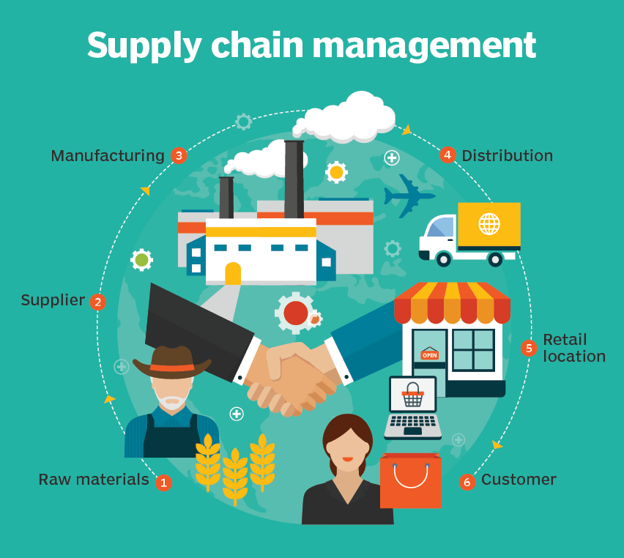
Exploiting partners
Which organisation(s) will bring the product to the market?
Connection to value chain/distribution channels
  Best option and alternatives for manufacturing and distribution of KER’s
    Proprietary manufacturing
    License manufacturing
Notes:
Along with the product and its market the execution power of the exploiting partners is key to make each KER not only a societal and technical success but also a commercial success.
At the time of the KAVA project application please have in mind the full supply chain to exploit the KER. An example of the supply of a physical product is shown on the picture in front of you.
Important for each step in the supply chain is to clarify whether or not the exploiting partner is able to control and manage to full supply chain on its own or a third party outside the project consortium is needed. Especially whether or not the exploiting partner is able to produce the KER itself, or that a license is provided to a third party to manufacture the KER.
The same goes for the distribution up to the final customer; can the exploiting partner do it, are specific Consortium members needed for sales distribution or is a third party required?
The supply chain concept also positions a KER in case it is not a direct consumable product in itself. A KER can be a half-finished product, for example food ingredients, that need to be assembled with other substances to manufacture a food product.

Slide 37
EIT Food financial return mechanism
COMERCIALISATION and go-to-market STRATEGY
Notes:
Now let’s have a closer look at the busines model for the exploitation of Key Exploitable Results, including the type of information that is required at the time of the application of KAVA projects to EIT Food.

Slide 38
Roadmap
Milestones for development and sales
Types of milestones for roadmap of exploitation:
KER fully developed in order to be exploited,
supplier or offtake agreements are signed,
a first commercial scale production plant,
first /launching customer(s),
certain threshold in sales volumes,
number of customers,
introduction in certain countries,
introduction to new type of customers etc.
Example Casing Seedling - Sales related Milestones
2020 Q4: 5 small scale pilots- total 25 m2 (first revenue: € 2,500)
2021 Q3: 10 large scale pilots - total 2500 m2 (€ 25,000)
2022 Q4: start commercial sales
2023 (1st full year of sales): 400,000 m2 (€ 3.2 mln)
2026 (5th year of sales): 25% market share, 25k customers and € 17,5 mln
Notes:
As Innovation Actions are targeted at bringing exploitation results to market shortly after the conclusion of the KAVA project, it is important that a clear roadmap to market introduction, growth and scaling will be developed. The better you can elaborate these elements already in the proposal phase, the higher the credibility of the exploitation chances.
Examples of the types of milestones that are expected to be drafted during the KAVA project application or show on this slide.
A further example of milestones is provided based the earlier example we discussed on the casing around young trees. As you can see a good defined milestone includes the features of the time at which the milestone is reached and is quantified in units and or in euro.
This example also shows a more or less a smooth sequential order of milestones within a KAVA project (with the first two milestones in the years 2020 and 2021) and most importantly the milestones beyond the KAVA project starting at 2022 with commercial sales.

Slide 39
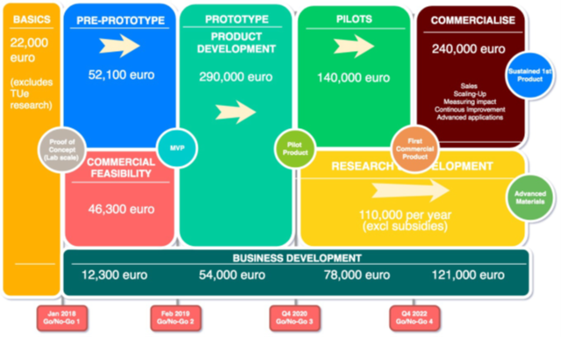
Roadmap
Milestones for development and sales
Notes:
Another way of thinking about the roadmap is shown on this slide, which also shows the relationship with the funding required and planned moments for go / no go decisions to go to a next phase, as shown at the bottom of this slide. This is just an example. The required funding per phase will obvioulsy depend on the specific project and KERs. Logically the funding size increases at the later stages. For exploitation phase of the KER EIT Food is mostly interested in the latest phase expresssed with a circle in this picture.

Slide 40

Go-to-market strategy based on assumptions and scenario analysis
It’s all about robust assumptions:
What are the key assumptions underlying operational costs, investments and revenues?
Are the quantified key assumptions robust, i.e. reliable, realistic, valid?
Assumptions need:
Reliable sources of information for each key assumption
Validity check with scenario analysis: are the financial outcomes (e.g. revenues, EBITDA, cash position) within acceptable barriers in a base / best / worst case scenario ?
 | Scenarios
Key assumptions | Base case | Best case | Worst case
Projection start year market introduction | 2019 | 2018 | 2020
Forecast period (YR) | 10 | 12 | 8
Corporate income tax | 25% | 21% | 30%
Year of market size data | 2018 | 2018 | 2018
Total available market (TAM) | 23.900.000.000 | 23.900.000.000 | 23.900.000.000
Serviceable available market (SAM) | 4.900.000.000 | 4.900.000.000 | 4.900.000.000
Serviceable obtainable market (SOM) | 70.000.000 | 70.000.000 | 70.000.000
Market share of SOM start year | 80% | 100% | 60%
Annual scale up rate sales volume | 1,5 | 2,0 | 0,8
Price per unit start market introduction | 830 | 910 | 785

Slide 41
Commercialisation Strategy to result in draft Cash Flow projections
Income statement (Profit & Loss Statement) and Cash Flow Statement
Revenues
EBIT from Income Statement
Operating Profit
Net Cash position
resulting from cash in- and outflows

Slide 42
Roadmap
Cashflow related to milestones
Product
Notes:
It is recommended to consider already during the proposal phase, how the exploitation of KERs will lead to revenues, break-even and profits (EBIDTA). For a sound business case eventually you need to indicate the different milestones on this exploitation path. Higher level , but already quantified, data in the KAVA proposal are likely to foster a positive evaluation and will facilitate further discussions with the EIT Food on financial sustainability mechanisms and agreement.

Slide 43
EIT Food financial return mechanism
COMMERCIALISATION AND FRM TEMPLATE
Notes:
Now let’s have a closer look at the busines model for the exploitation of Key Exploitable Results, including the type of information that is required at the time of the application of KAVA projects to EIT Food.

Slide 44
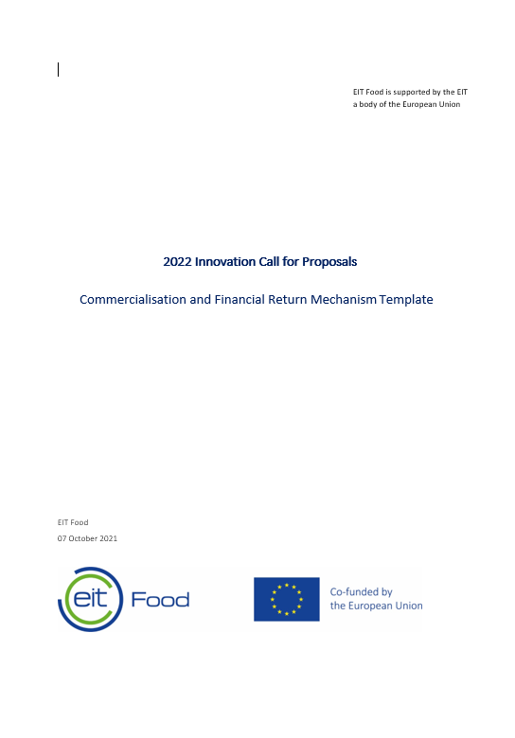
Commercialisation and Financial Return Mechanism plan
2. Clear Key Exploitable Results
5. Exploitation rights on the IP/Freedom to operate
1. Value Proposition and Unfair Advantage
3. Clear Exploiting party/parties
4. Scope of activities and responsibilities of exploiting party
6. Clients /client group identified & fee model identified
11. Proposed Financial Return Mechanism
7. Serviceable Obtainable Market identified
8. Market introduction / distribution channels
9. Roadmap Go-to-Market and ScaleUp milestones
10. Revenues Of Key Exploitable Results
Notes:
So, as you saw, the key elements for a sound self/developed FRM are 1) Clear KERs, 2) a clear agreements on IPR and exploitation rights between the partners, 3) a valuable Business Model around the KERs, 4) quanitified and credible business cases for the exploiting partners, 5) a risk adjusted FRM that matches the standard mechanism and 6) a Clear Agreement between the partners about the responsibilities to pay-the FS contribution to EIT. They need to be developed at a very early stage, for a large part already before the start of the project, and be clearly outlined in the proposal. In the following part of the webinar, we will go a bit deeper into each of these elements, to provide you with some theoretical background and context to be used when elaborating your proposal.

Slide 45
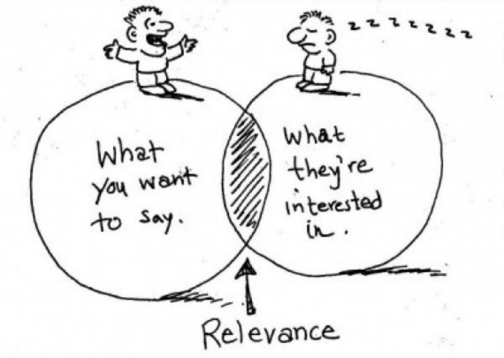
Commercialisation and Financial Return Mechanism Template
Value Proposition and Unfair Advantage
  Questions to be answered:
  What is your single, clear compelling message; what are the features of your solution?
  Please describe the value proposition of your innovative solution according to the definition LEAN Business Model Canvas.
  Please describe the Unfair Advantage of your innovative solution (something that cannot be easily copied or bought).
  Optional supporting documentation:
  Attach an analysis report following the structure of the Value Proposition Canvas.
Notes:
Optional supporting documentation: Attach an analysis report following the structure of the Value Proposition Canvas.
Optional supporting documentation: Attach a Summary of previous research / lab / Proof of Concept results, quantified, when possible.

Slide 46
Commercialisation and Financial Return Mechanism Template
KEY EXPLOITABLE RESULTS (KER’s)
# KER | Title of KER | IP owner - responsible
1. |  | [ one of the KAVA consortium partners ]
2.
3.
KER # | Exploiting party of KER | Part of consortium KAVA project? State yes or no
1. | [ one of the KAVA consortium partners ]
2.
  Optional supporting documentation:
  Attach a Summary of previous research / lab / Proof of Concept results, quantified, when possible.

Slide 47
Commercialisation and Financial Return Mechanism Template
Scope of activities and responsibilities of exploiting party
 | contractual basis of the exploitation | b) exploiting party manufactures/ executes the KER | c) If not, which party generates (manufactures) the KER?
KER # 1 | IP owner / IP license | Yes / No | [ Name of third party ]
KER # x | IP owner / IP license | Yes / No
 | d) Fully or partly distribution of KER by exploiting party | e) Sales distribution model exploiting party | f) Sales distribution model third party distribution partners, if applicable
KER # 1 | Fully / partly | [ max. 3 sentences ] | [ max. 3 sentences ]
KER # x | Fully / partly
 | g) Sales channels of KER
KER # 1 | KAVA consortium partner (if so please name partner) / Existing network of exploiting party (if so please provide names) / online sales / other, please specify type of sales channel (e.g. supermarkets, food producers etc.)
KER # x

Slide 48

Commercialisation and Financial Return Mechanism Template exploitation rights IP
  Questions to be answered:
  Did you carry out a Freedom to Operate Analysis?
  Is there third-party IP you need to take into consideration when exploiting your KER? If so, how will this be arranged?
 | Freedom to Operate Analysis is executed for IP of KER? | IP by third party to take into account when exploiting the KER? | In case of third party IP, how will this be arranged?
IP KER # 1 | Yes / No | Yes / No | Provide short description in approx. 2-3 sentences
IP KER # X | Yes / No | Yes / No

Slide 49
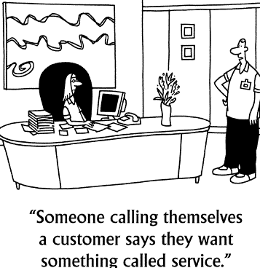
Commercialisation and Financial Return Mechanism Template
Clients /client group identified & fee model identified
  Questions to be answered:
  Who are the expected main clients of each KER? How did you choose your entry price?
  Please describe the clients per KER.
  Provide specific client names or client types, i.e. retailers, manufactures, farmers etc., who could partly be the KAVA’s consortium partners.
KER # | Client name or Client type | Fee model
1
X

Slide 50
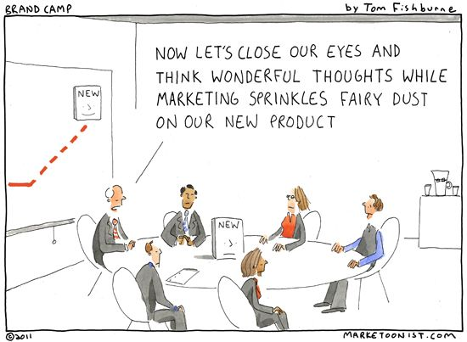
Commercialisation and Financial Return Mechanism Template
Clear problem and market need identified
  Please provide a summary of the market analysis report with:
  Societal and/or economic problem related to one or more of the innovation clusters
  General solution path / approach to this problem (not yet being the solution developed during the KAVA)
  Total addressable market both historic and outlook, market segments in case of multiple applications of solution and range of types of prospective clients
  Historic and prospective competitors with alternatives to the solution developed during the KAVA

Slide 51
Commercialisation and Financial Return Mechanism Template
Serviceable Obtainable Market identified
  Describe and quantify to which market segments each KER is to be exploited.
  Please copy and complete the table below if you have more than one KER.
  MANDATORY Supporting Documentation: Please provide documentation explaining on which expected SOM and market share your quantification is based on.
SOM for KER # 1:
1. Name market segment 1: | [ e.g. client type(s) or client name(s) (which can be consortium partners), specific region(s) / countries ]
2. Units in: | Please select relevant unit for KER: Persons, kg, ltr, m2 or describe other type of unit
 | 2022 | 2023 | 2024 | 2025 | 2026 | 2027 | 2028 | 2029 | 2030
3. SOM market segment 1 in units
Market share segment 1 (1-100%)
4. Sources estimated SOM | [ e.g. draft /expected offtake agreements, letters of intent customers, market research reports, competitor analysis etc.]

Slide 52
Commercialisation and Financial Return Mechanism Template
ROADMAP GO TO MARKET AND SCALE UP MILESTONES FOR KER’S
  key milestones that represent a feasible commercial growth path (scale up pace) for each KER in the coming 5 to 10 years.
Milestones KER # 1
Milestones description | Time (Quarter, Year) | Targeted market introduction channels and SOM (quantify channels and SOM)
KER # 1 fully developed for market introduction
….
….
….
MANDATORY Supporting Documentation:
Product Readiness Level: evidence documenting the status of the activities required to launch the innovation in the market. Business Plan that includes the description of the sales/distribution channels for the described SOM

Slide 53
Commercialisation and Financial Return Mechanism Template
Revenues Of Key Exploitable Results
  Provide the type of estimated revenue streams of each KER for the exploiting party
KER # | sales of product | sales of service
1 | Yes / No | Yes / No
X | Yes / No | Yes / No
Please provide an estimation of the annual revenues in euro per KER in line with the previous sections on clients /client group identified & fee model identified, commercial scale up milestones and the serviceable & obtainable market for each KER.
In € | 2022 | 2023 | 2024 | 2025 | 2026 | 2027 | 2028 | 2029 | 2030
Revenues KER 1
Revenues KER x
Total Revenues

Slide 54
Commercialisation and Financial Return Mechanism Template
Proposed Financial Return Mechanism (1/3)
1. Is your proposed Financial Return Mechanism (FRM) based on revenue sharing?
Please state: Yes or No.
In case of ‘yes’ please go to question 2 and in case of ‘no’ please go to question 3.
2. If your proposed FRM is based on revenue sharing, please complete the features in the table below for each KER.
KER # | % of revenues shared | Start year of revenue sharing | End year of revenue sharing | Total revenues shared per KER with EIT Food in €
1
X
 |  |  | Total in €
3. In case you propose another base for your self-developed Financial Return Mechanism than revenues sharing please specify how you propose to calculate a financial return for EIT Food
Notes:
This table describes the elements on how you propose to calculate the amount of revenues shared with EIT Food, referring to the estimated revenue streams per KER.

Slide 55
Commercialisation and Financial Return Mechanism Template
Proposed Financial Return Mechanism (2/3)
4. Please provide your proposed timing for the project financial return(s) to EIT Food for revenue sharing, lump sum or other mechanism, after the end of the KAVA project.
In € | 2022 | 2023 | 2024 | 2025 | 2026 | 2027 | 2028 | 2029 | 2030
Projected financial return to EIT Food for KER 1
Projected financial return to EIT Food for KER 2
Total Projected financial return to EIT Food
Sum of all revenues shared annually = ROI of EIT Funding
Notes:
This table describes the elements on how you propose to calculate the amount of revenues shared with EIT Food, referring to the estimated revenue streams per KER.

Slide 56
Commercialisation and Financial Return Mechanism Template
Proposed Financial Return Mechanism (3/3)
Please describe how the exploiting party of each KER provides clear insight in the realised revenues of the KER(s)
Please provide the name and department of the department and duly authorized person to sign the Financial Return Mechanism Agreement with EIT Food
Exploiting party for KER #
Organisation name
Department
Duly Authorised person to sign
E-mail of authorized person
Telephone number of authorized person
Notes:
This table describes the elements on how you propose to calculate the amount of revenues shared with EIT Food, referring to the estimated revenue streams per KER.

Slide 57
RECAP
RECAP - SOME KEY RULES FOR DESIGNING YOUR FRM

Slide 58

RECAP - SOME KEY RULES FOR DESIGNING YOUR FRM
Remember: FRM is part of the evaluation!
Exploiting party to be in lead! Will sign the FRM agreement with EIT Food on behalf of the consortium
Link your FRM to the business case
Quantify projected revenues over time related to your Key Exploitable Results
Qualify the type of expected revenues:
    Product sales
    Service sales
    License-income
Provide elements that demonstrate a credible growth-path (see business model)
Monetize and plan your proposed expected Financial Return to EIT
At least provide for a return-on-investment of ≥50% (risk-adjusted) – sharing your success with EIT!

Slide 59


Slide 60

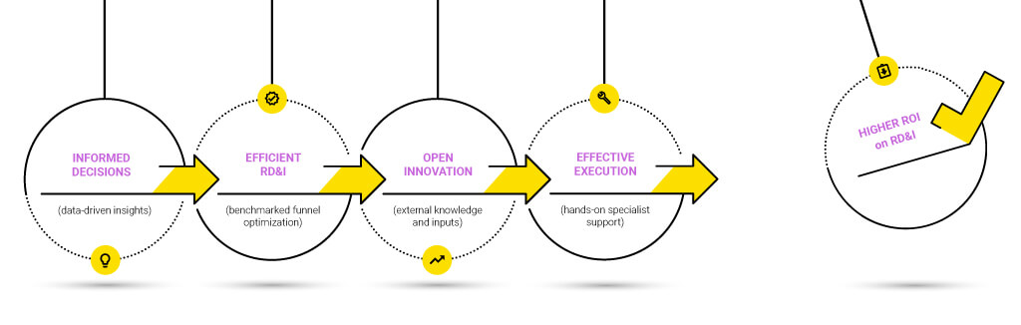
Good luck!

